Slide 1

Predictive Analysis On IPL -- Indian Premier League
Gulladurti Tarunkanth Reddy
Beeravalli Vamshi Reddy
Routhu Praveen
Majji Naveen Kumar

Slide 2
Introduction
The IPL is an exciting and wonderful game which will give more happy while watching the match along with some tension. The project is about to reduce the tensions of fans of cricket especially at the last overs of a match. And to bring all related attributes that are required for the project in one place i.e. Interface or Website.

Slide 3
Why we need IPL Predictions & Analysis
Analyzing Players performances and their strengths
1
Some Categories like gambling, betting which are illegal are converted into legal activities in the form of dream11, bet365.
2
To study the performances of IPL with past data which can see easily with Tableau like Wins and Loses, Wickets taken, Runes Scored, etc.
3
Effective quick decisions can be taken on toss and toss opting.
4

Slide 4




Major Components of our project
Frontend
Using HTML and CSS designing a structured website
Machine Learning Algorithms
Implementing ML algorithms using Python to analyze the data
Tableau
It is flexible tool for data visualization
Backend
This project analysis and all are made available for users using Website especially ML Algorithms which are deployed.

Slide 5
Stages of Project
Data Collection using Kaggle Website
Data Visualization using Tableau
Deploying Python programming Algorithms and Models
Designing Website
IPL Analysis and Predictions available online through our website

Slide 6

Web Interface
Predictive Analysis On IPL

Slide 7
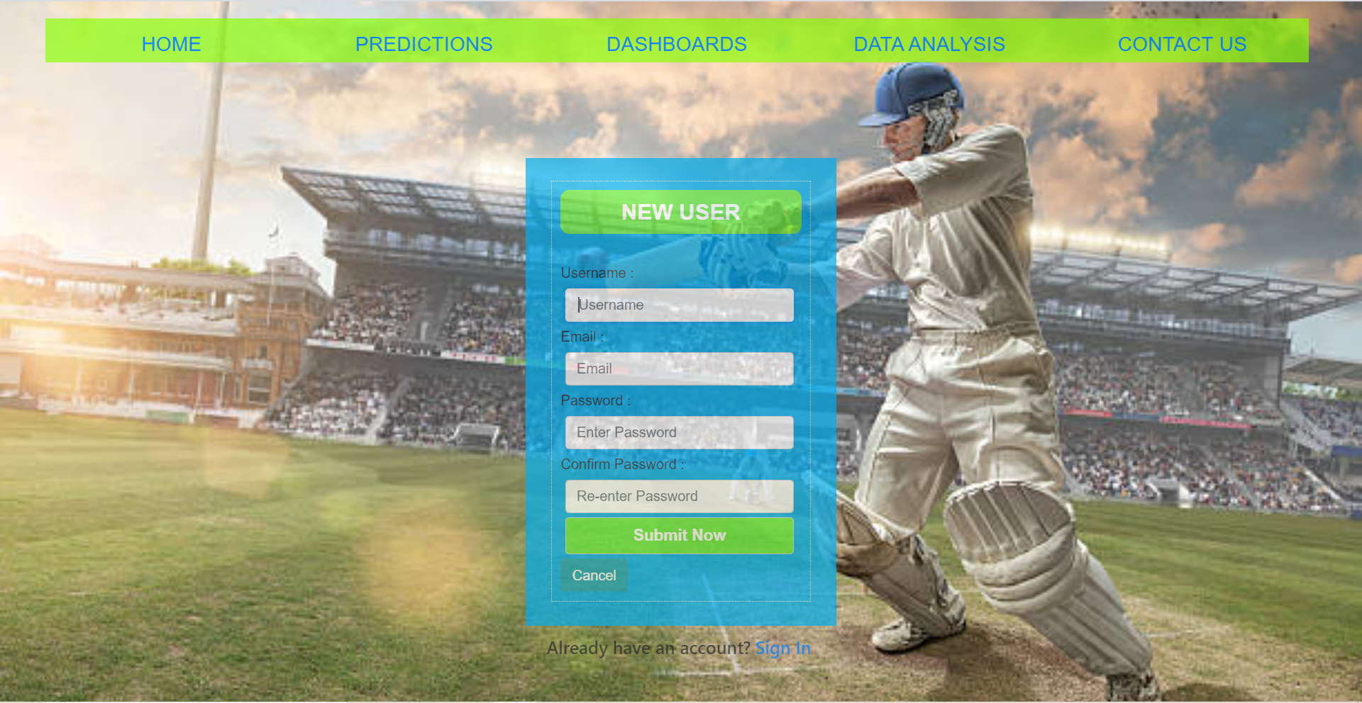

Slide 8
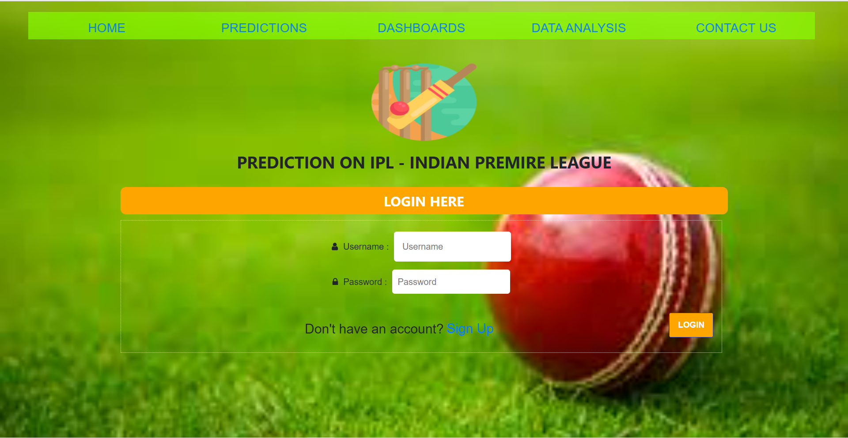

Slide 9
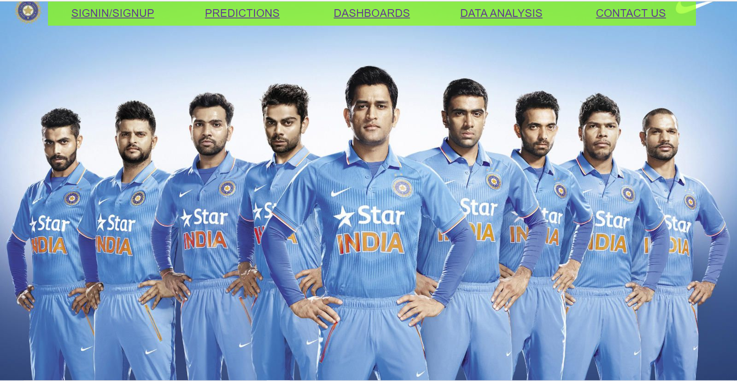

Slide 10
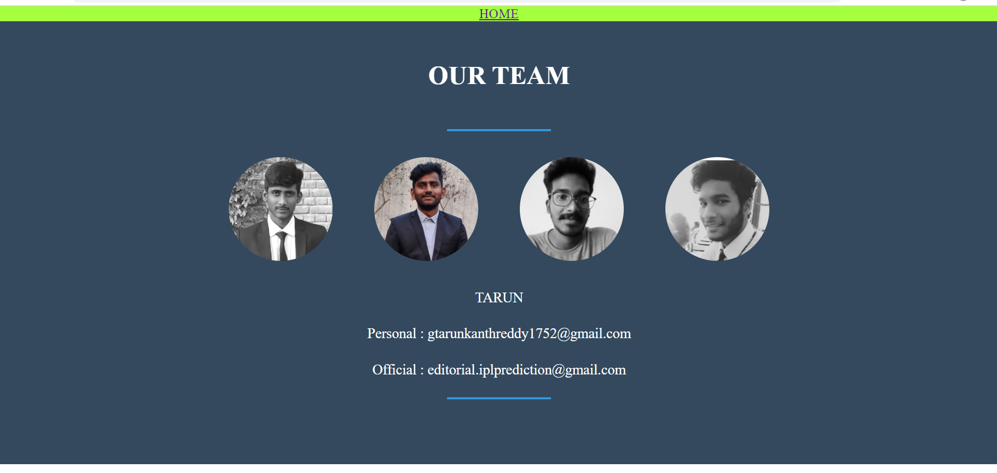

Slide 11
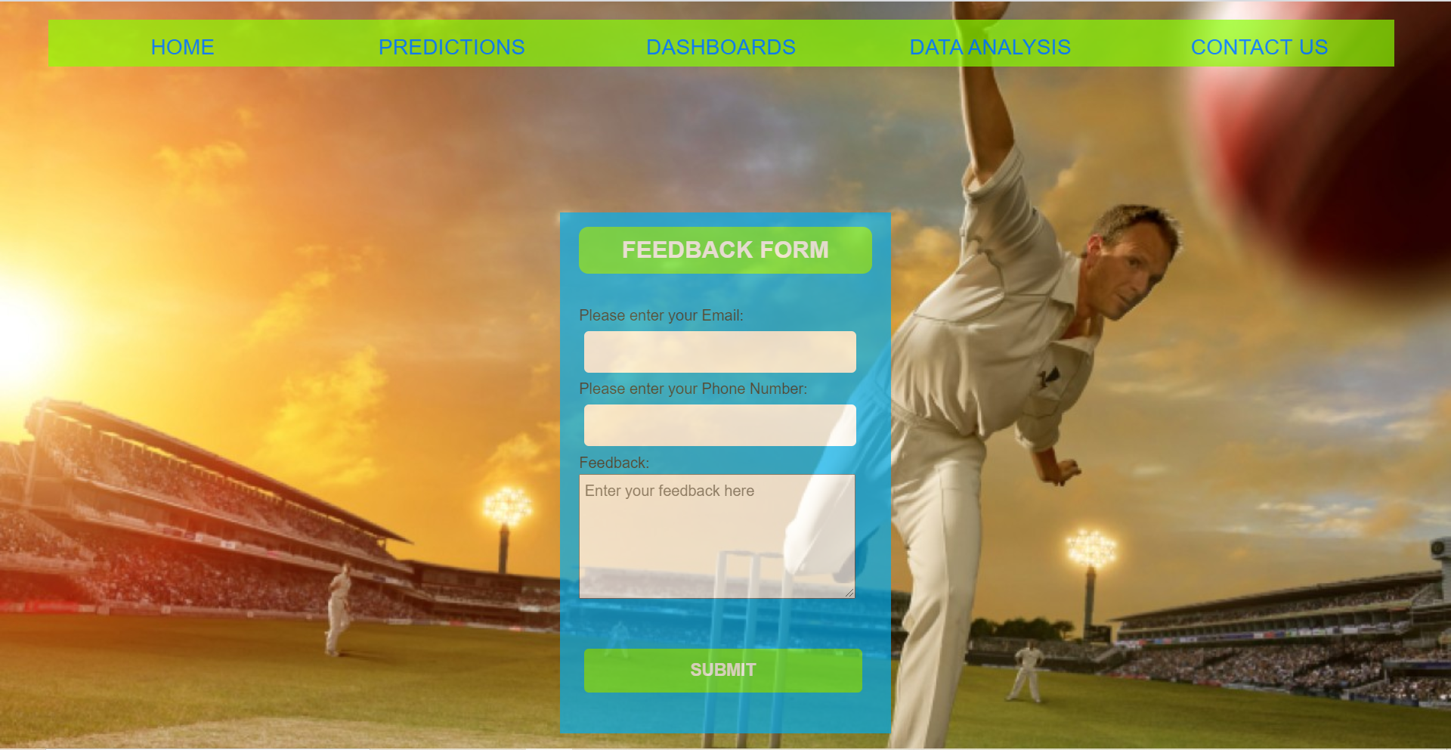

Slide 12
Visualization
Predictive Analysis On IPL

Slide 13
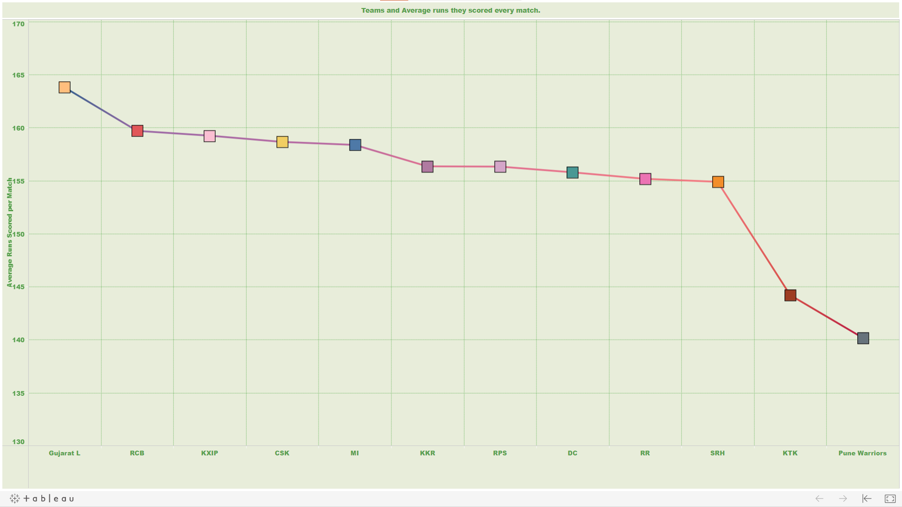

Slide 14
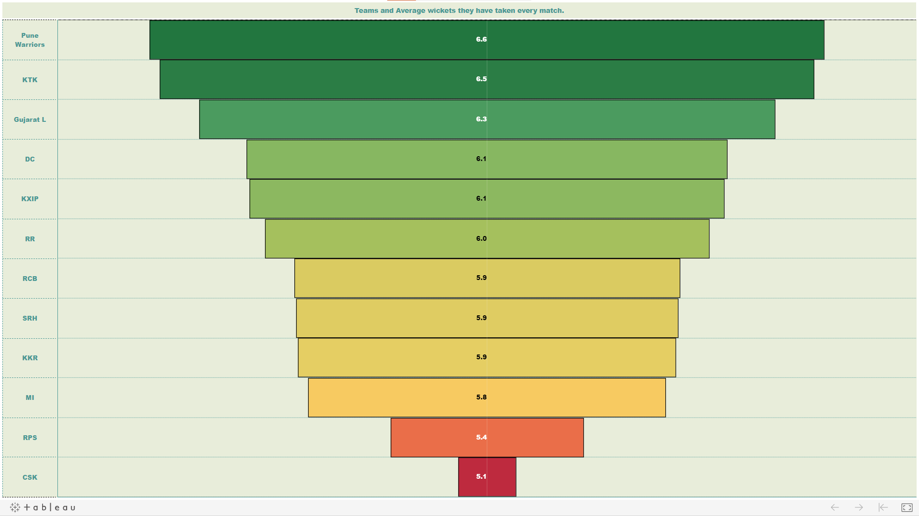

Slide 15
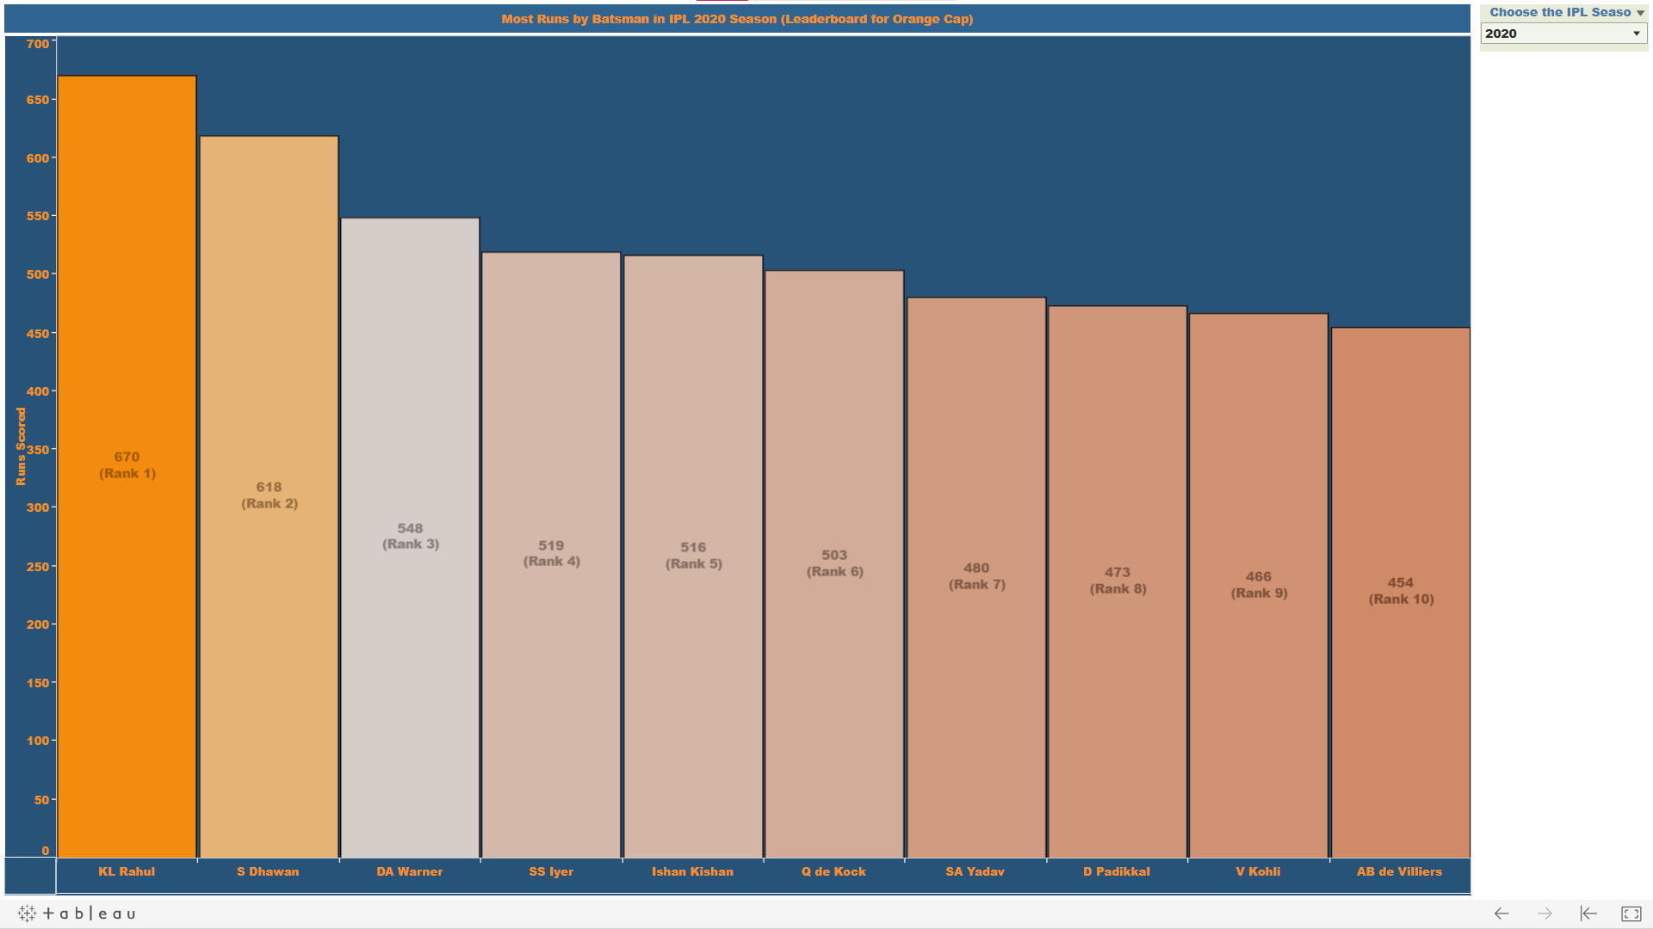

Slide 16
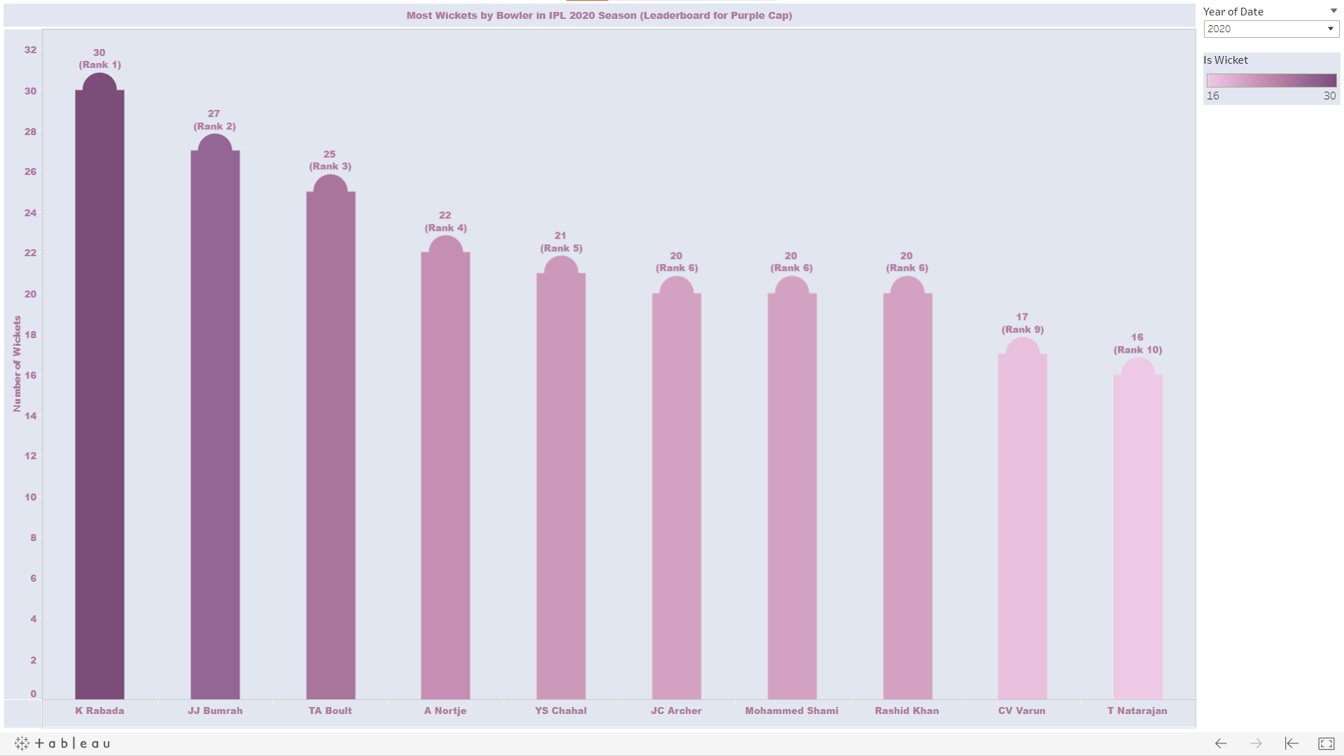

Slide 17
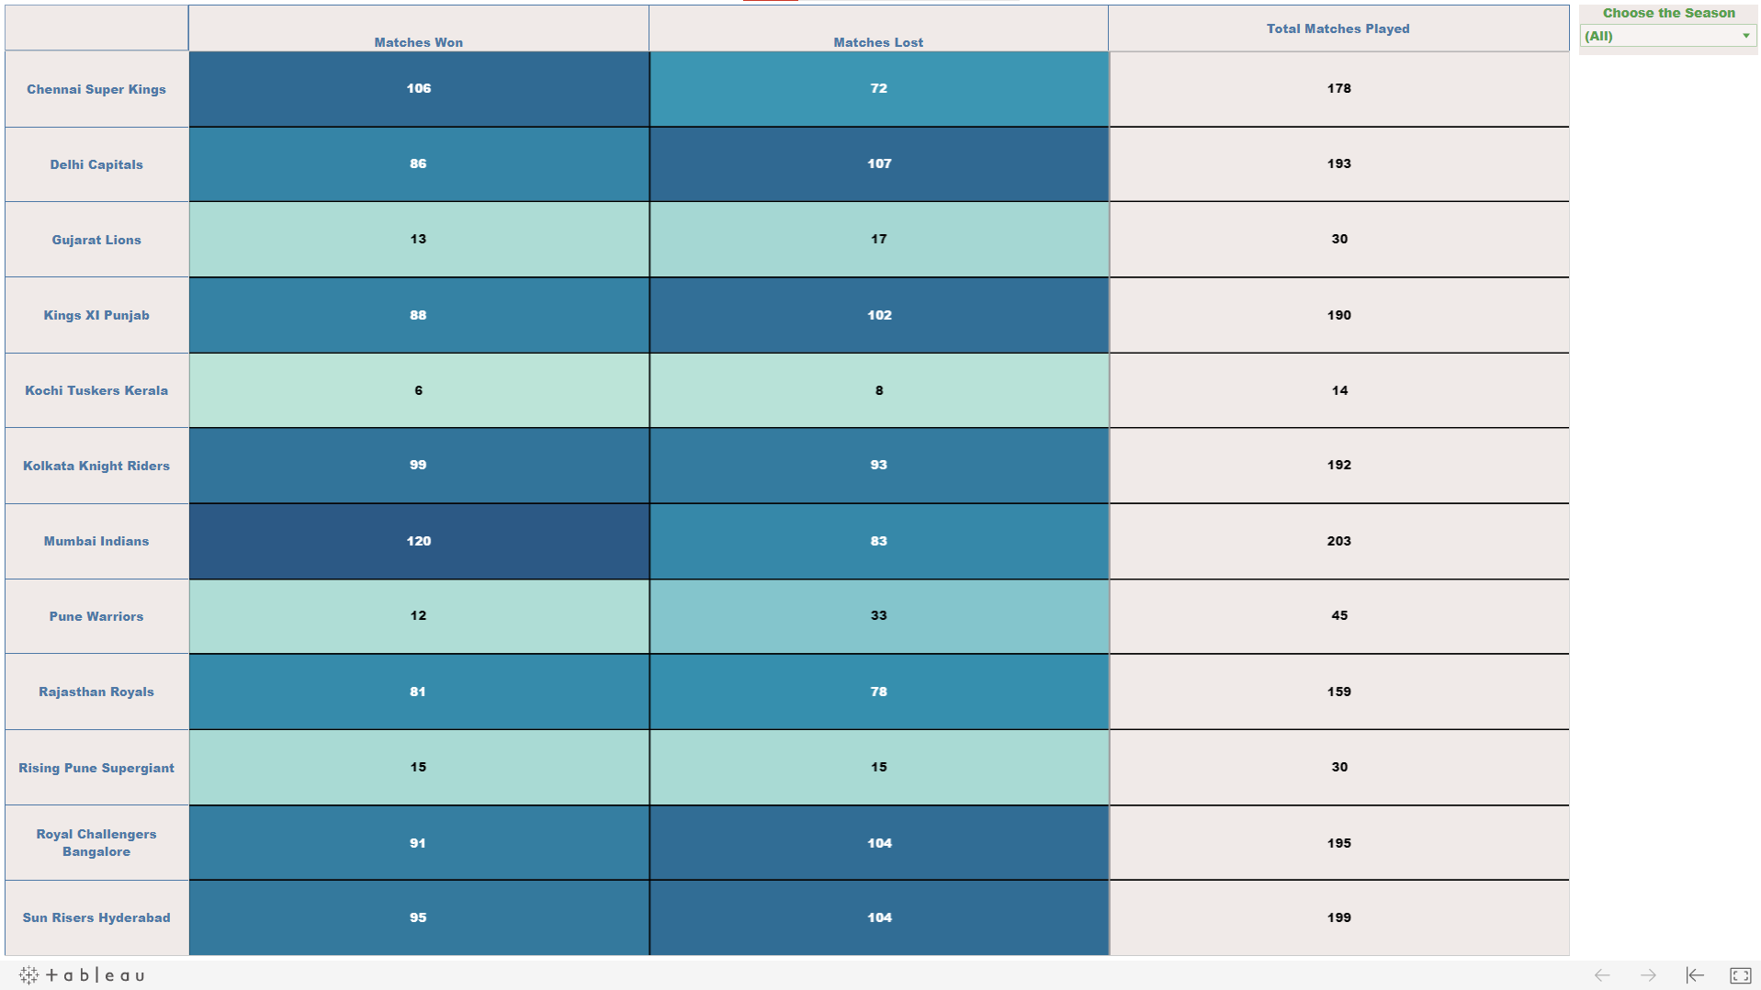

Slide 18
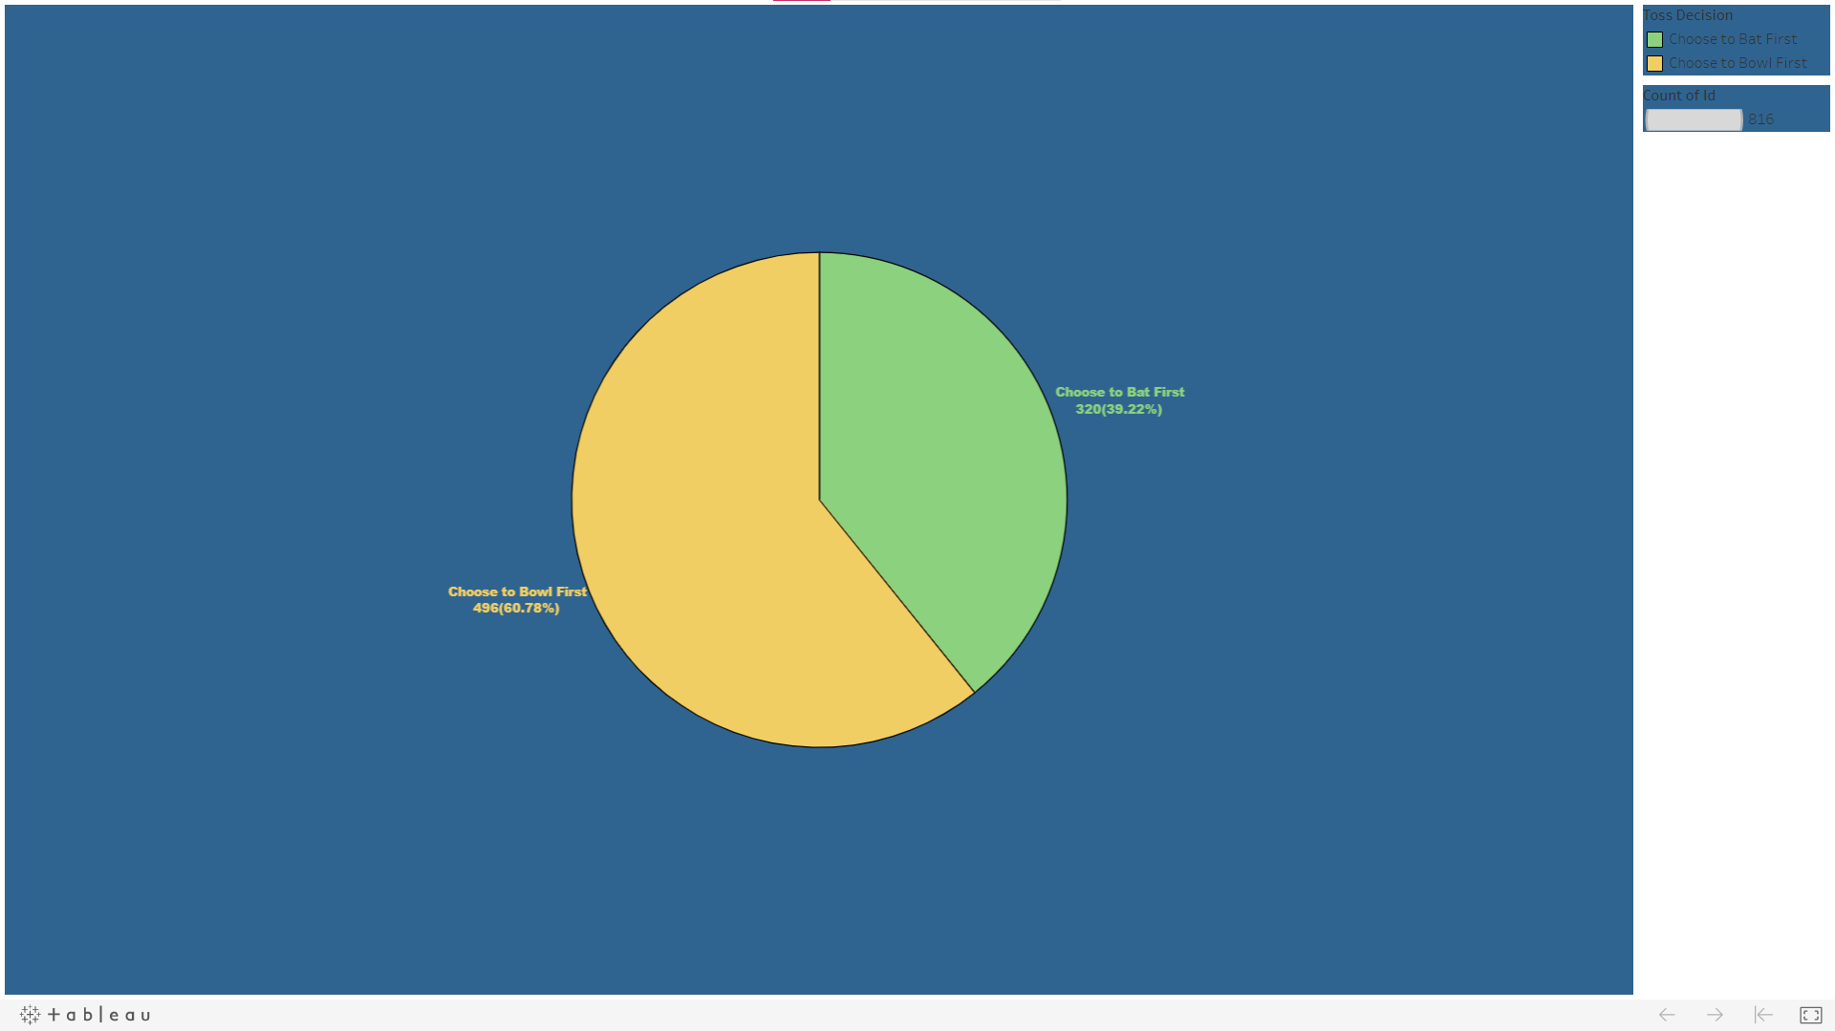

Slide 19
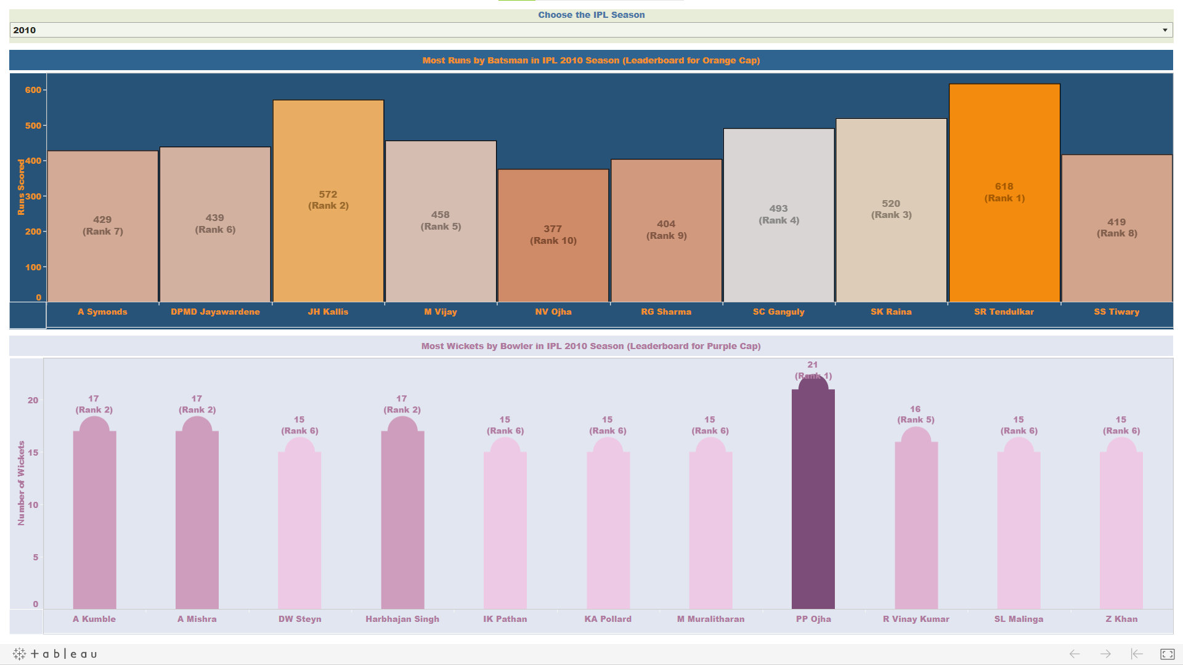

Slide 20
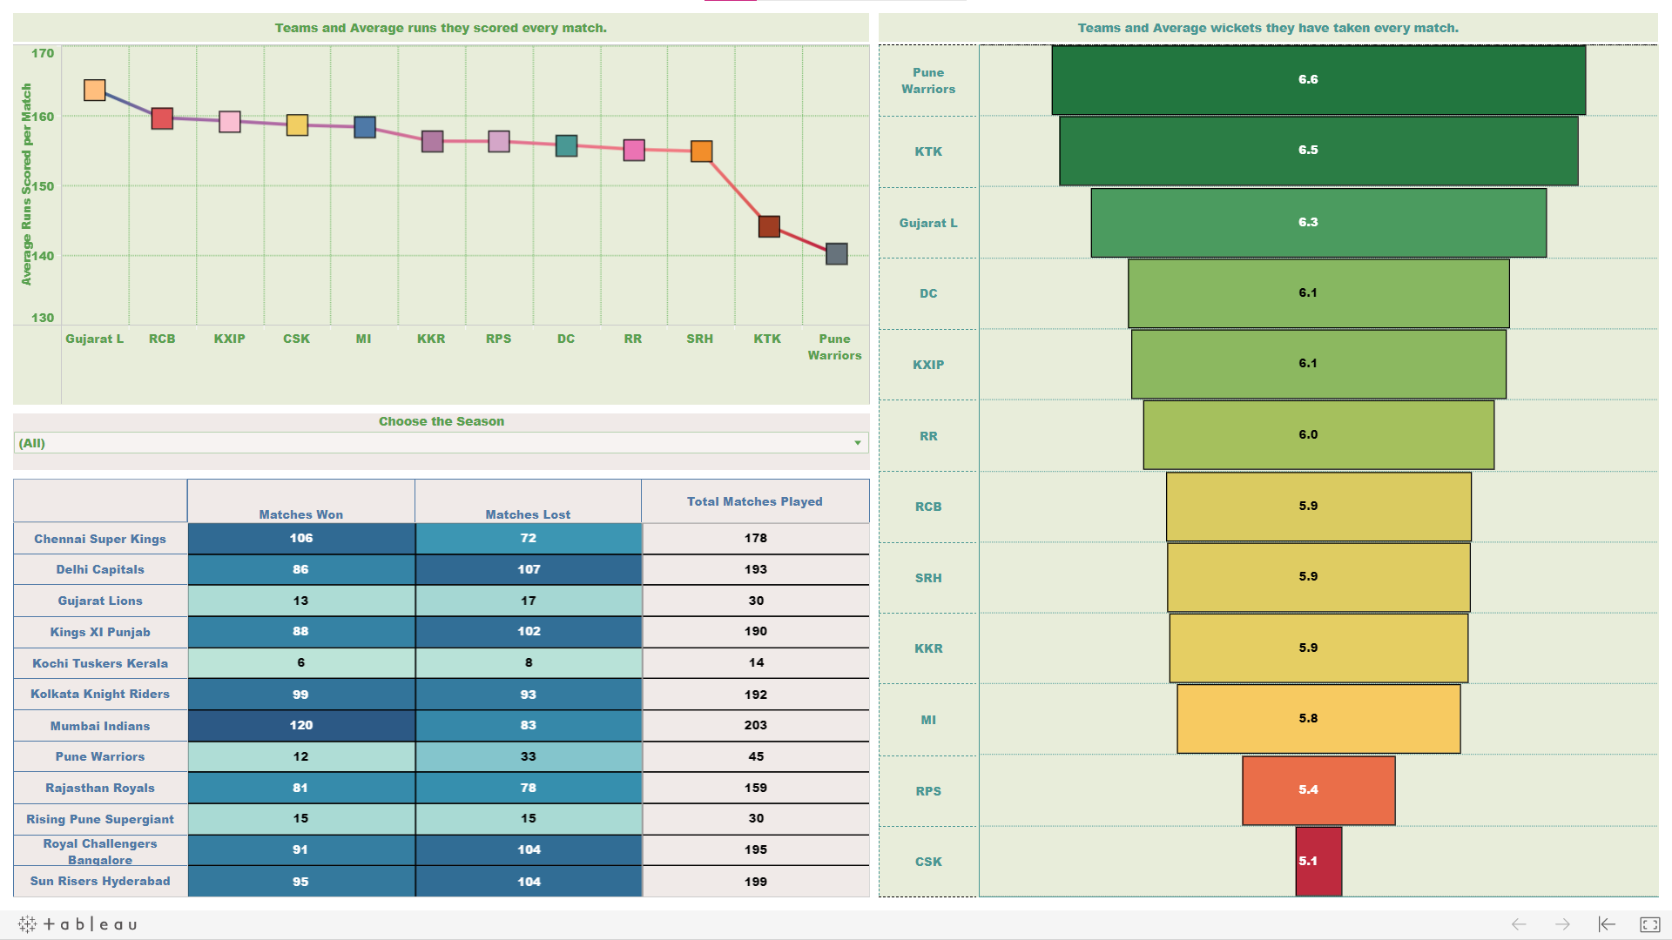

Slide 21
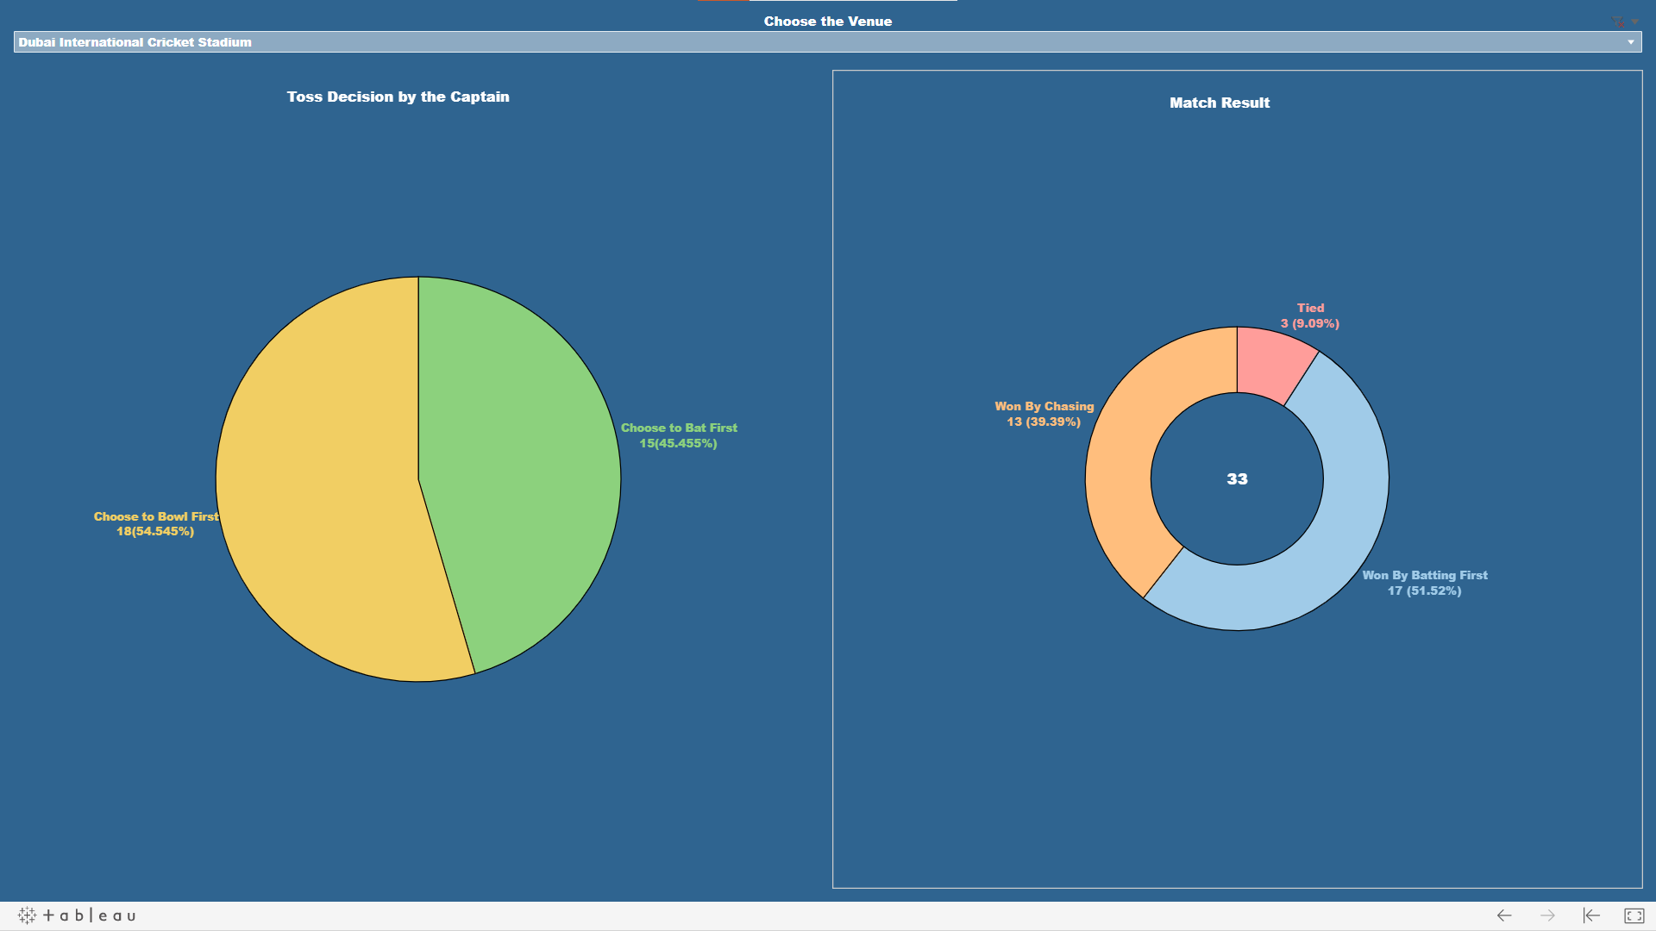

Slide 22
Machine Learning
Predictive Analysis On IPL

Slide 23
Machine Learning
Machine learning (ML) is the study of computer algorithms that improve automatically through experience and by the use of data. It is seen as a part of artificial intelligence. Machine learning algorithms build a model based on sample data, known as "training data", in order to make predictions or decisions without being explicitly programmed to do so

Slide 24
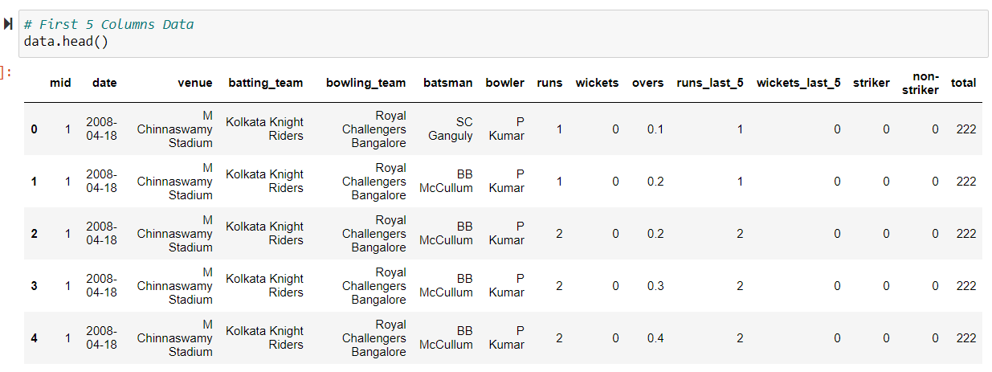

Slide 25
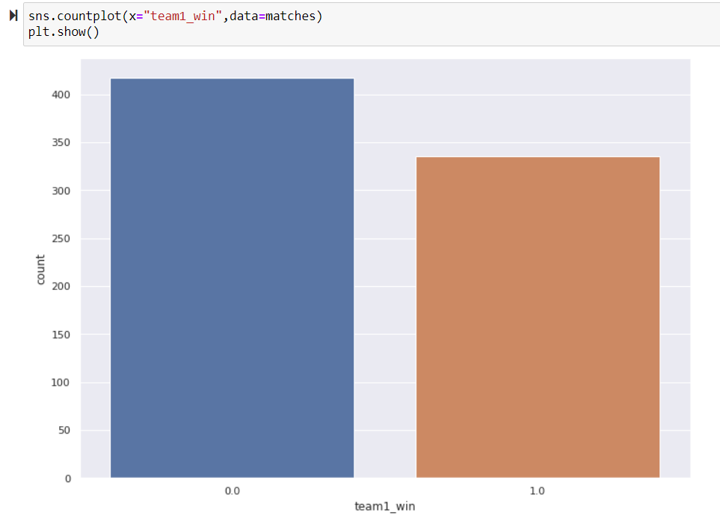

Slide 26
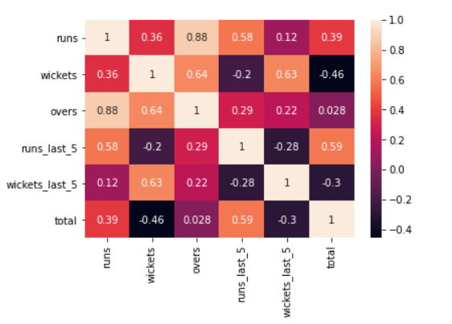
Heat Map

Slide 27
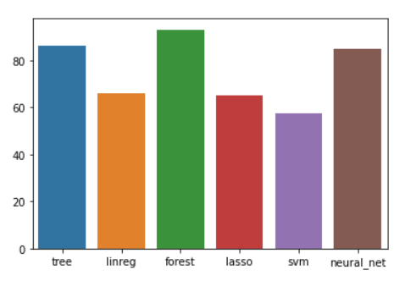

Slide 28
Django
Django is a high-level Python web framework that enables rapid development of secure and maintainable websites. Built by experienced developers, Django takes care of much of the hassle of web development, so you can focus on writing your app without needing to reinvent the wheel.

Slide 29
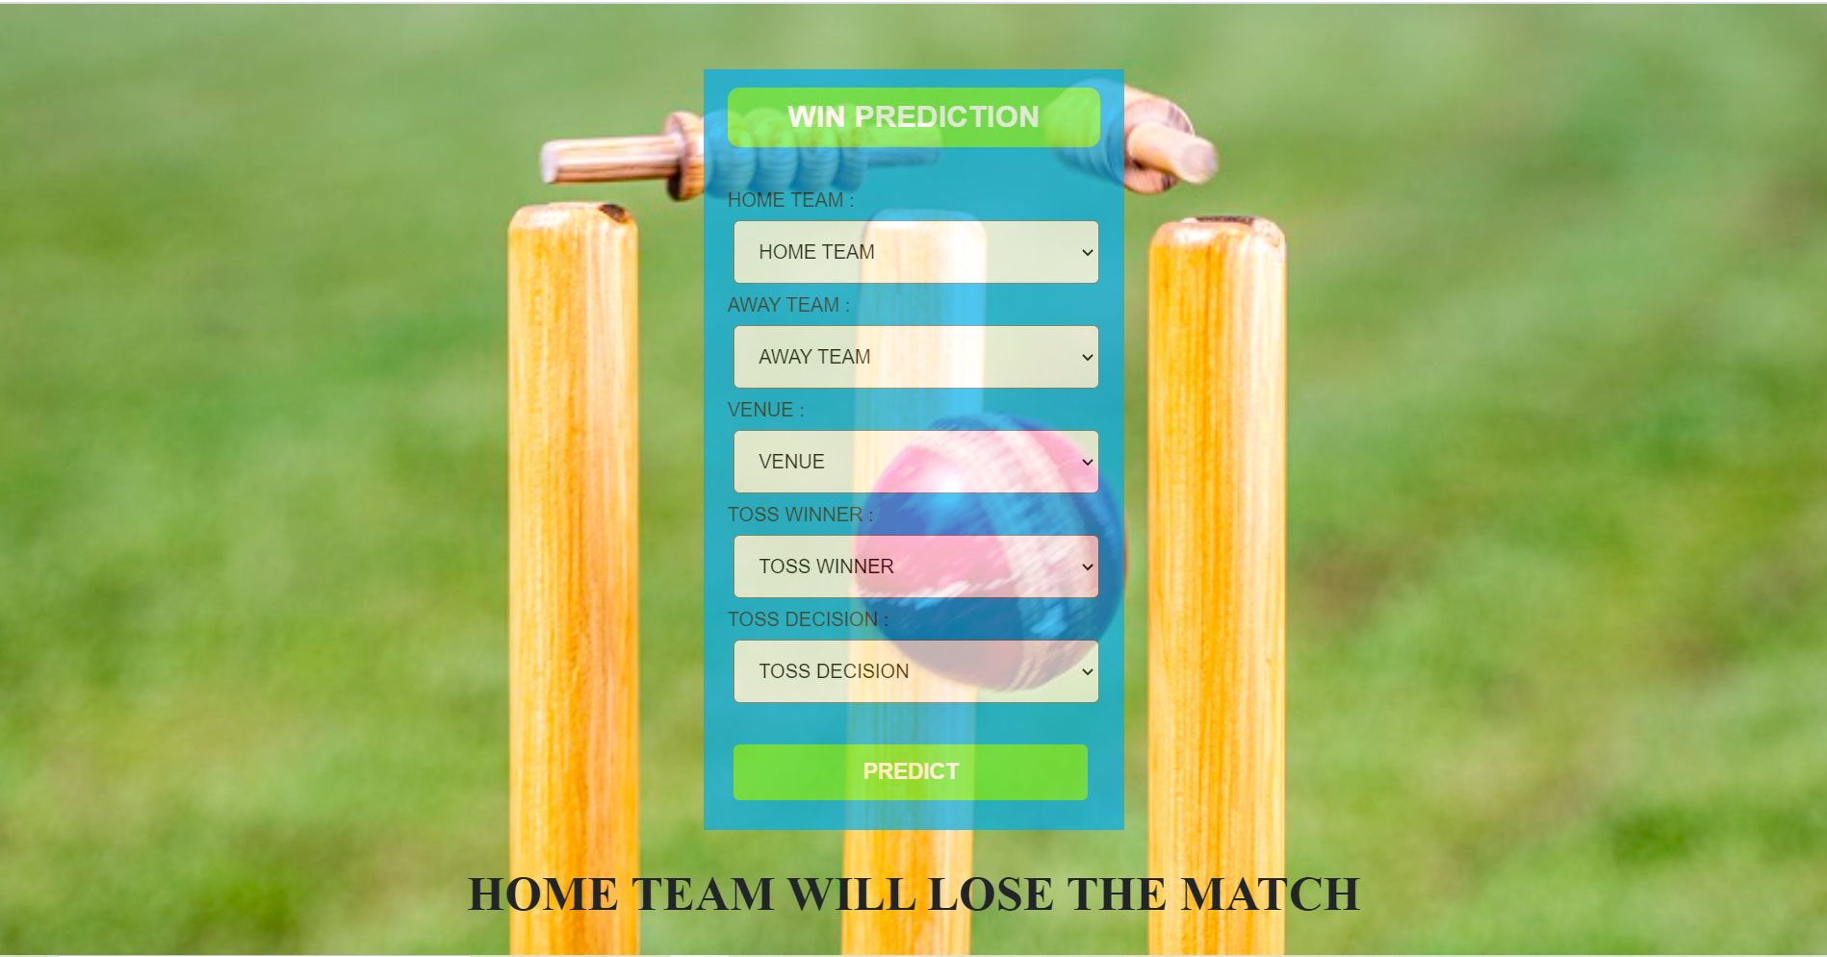

Slide 30
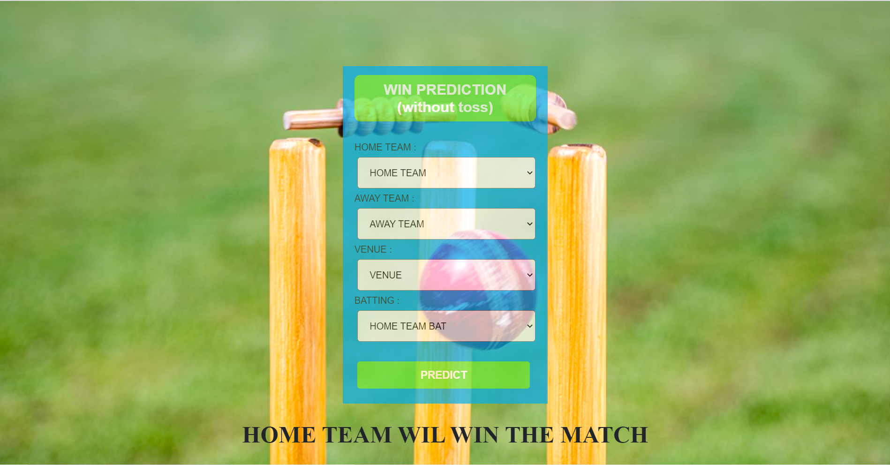

Slide 31
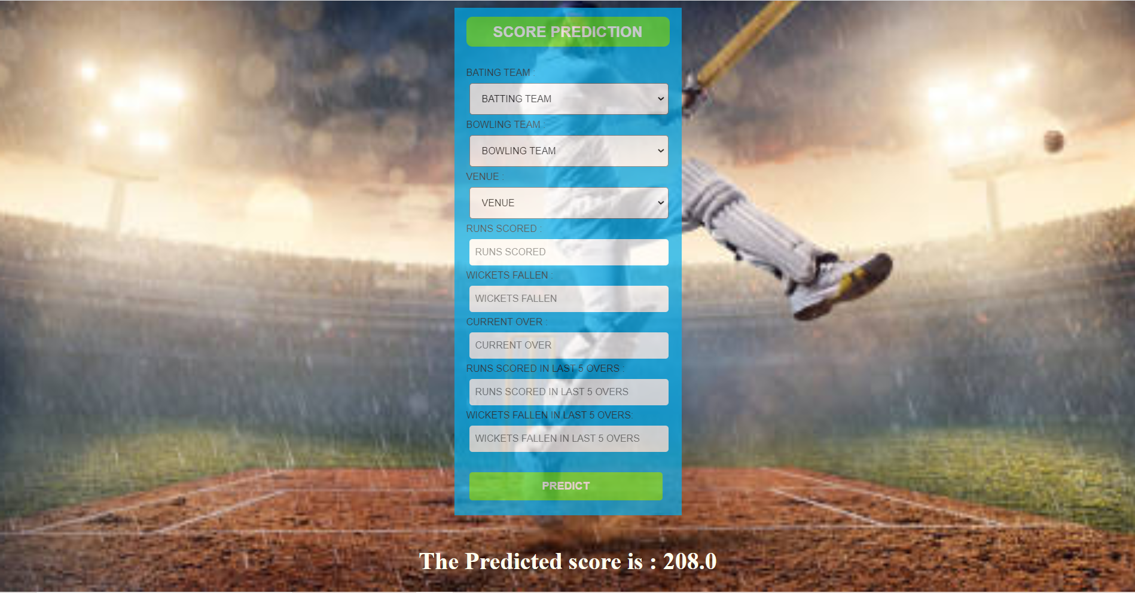

Slide 32
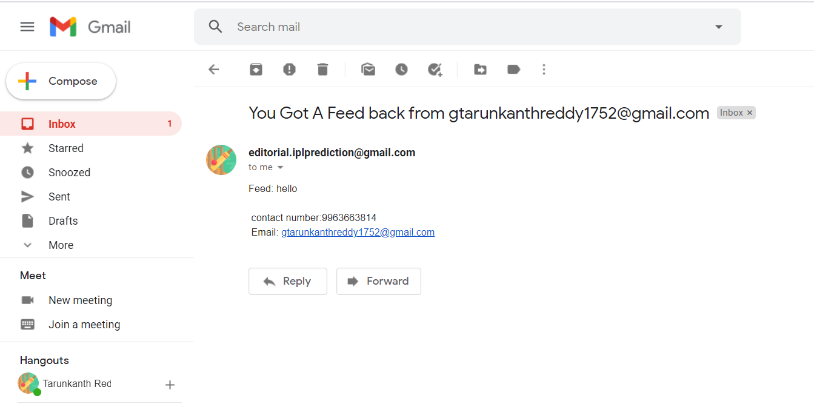

Slide 33
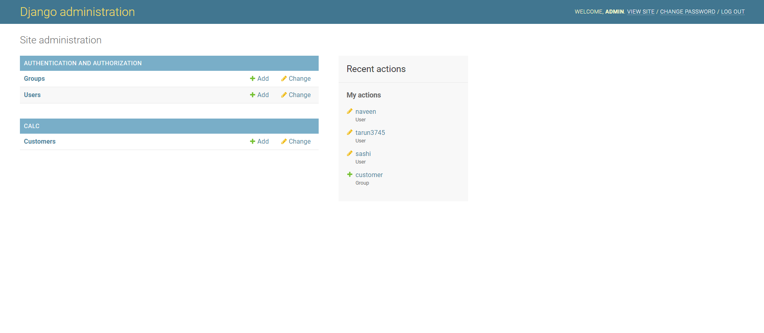

Slide 34
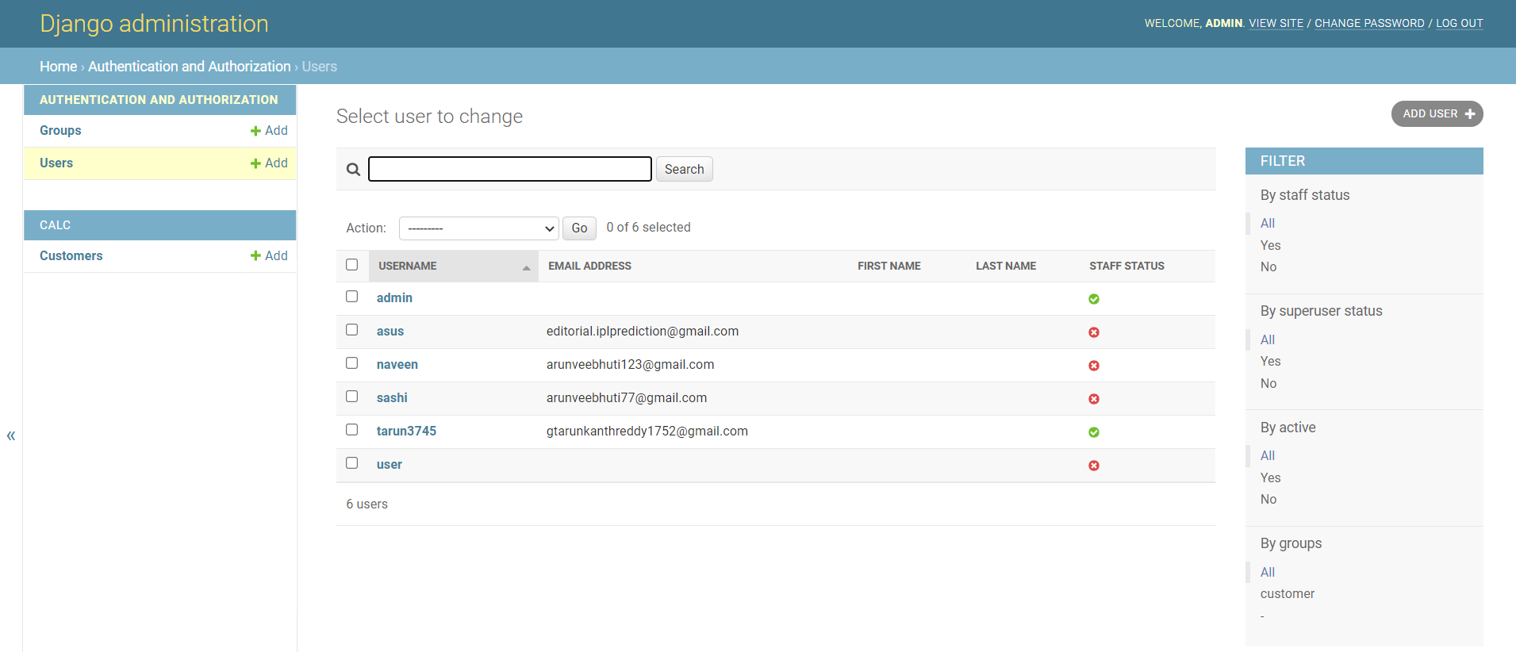

Slide 35
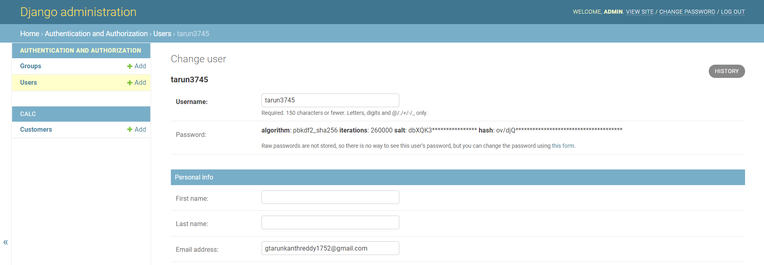

Slide 36
THANK YOU

